Slide 1


SPIRITUAL PATHWAY OF BRAIN INJURY
A Shaken Sense of Self
© Keatley 2021

Slide 2
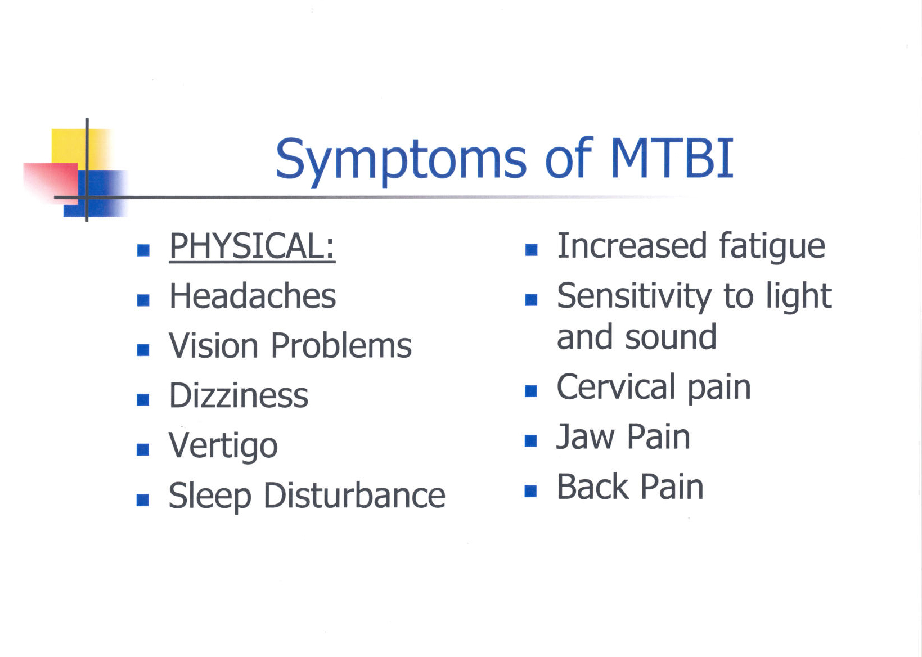
© Keatley 2021

Slide 3
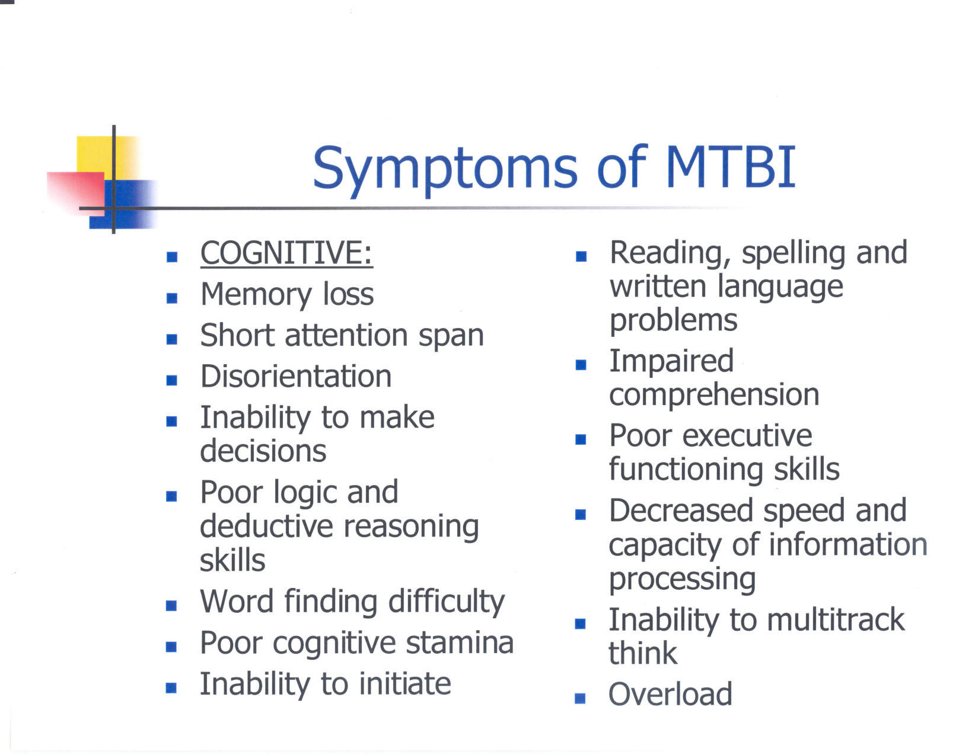

Slide 4
Symptoms of MTBI
Emotional Symptoms
  Shaken Sense of Self
  Depression
  Anxiety
  PTSD
  Near Death Experiences

Slide 5
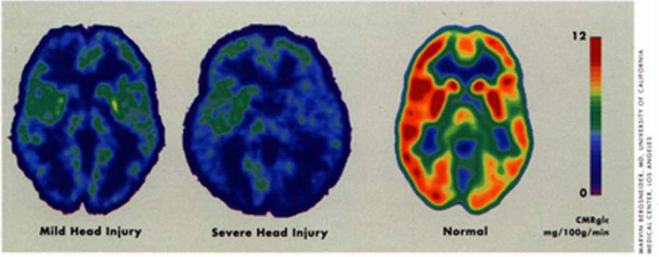
Glucose Utilization

Slide 6
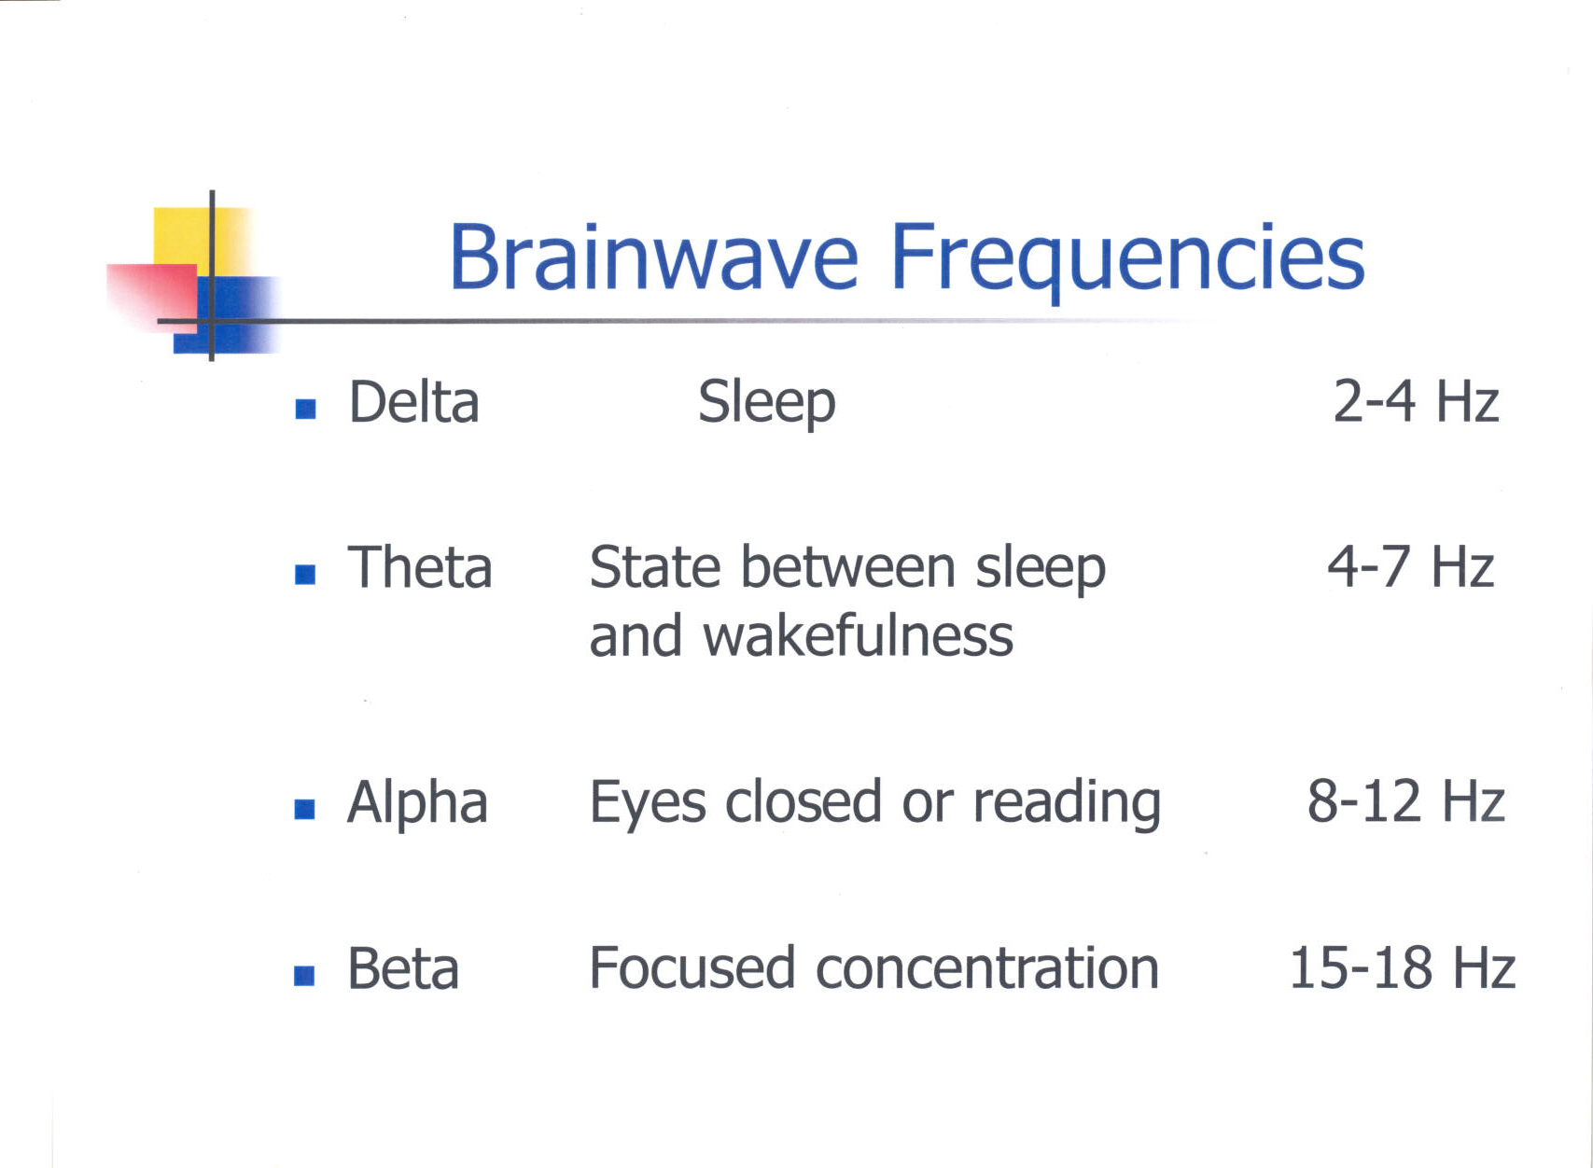

Slide 7
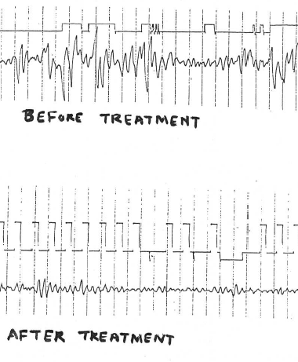
EEG Brainwave Biofeedback

Slide 8
Questions to Ponder
If you had the opportunity to re-live this event (time of your life due to brain injury) would you do it again?
What do you believe the purpose or reason for your brain injury was?

Slide 9
Qualities Gained from the Experience
Compassion for others
Humility
A knowing beyond analysis
Gratitude for life
Self-acceptance
Change in expectations
Faith that things will be ok
Patience and Endurance

Slide 10
Lets Talk About……
Invisibility—”you look fine so you must be fine”
Neuroplasticity-the brain ability to form new neural connections and develop new skills.
Resiliency—The capacity to recover from difficulties
Heightened Creativity
Near Death Experiences
PTSD
Grieving and Mourning (grieving the loss of self)

Slide 11
Continue the Conversation
Dark Night of the Soul—Suffering, Loneliness, Transcendence
Heightened Sensitivity--Perceiving what others are feeling in your surroundings
Knowing what others are Thinking
Yearning for a divine or spiritual connection
You’re Not Alone

Slide 12
Thoughts on Your Professional Role
Modify the Environment (turn down lights, close blinds, talk quietly, turn off background sounds like fountains or music)
Modify the counseling process (speak more slowly, give pauses for patient to process questions, give breaks because of fatigue)

Slide 13
Professional Role
Educate the patient about the elements of TBI (neuroplasticity, time frame for healing, how to work with professionals, identifying support systems, energy allocation, etc.)
Recognize that patients may need help with practical activities of daily living. Provide community resources.
Use other patient stories as guideposts for healing.
Validate the process of recovery. Give Hope.

