Slide 1
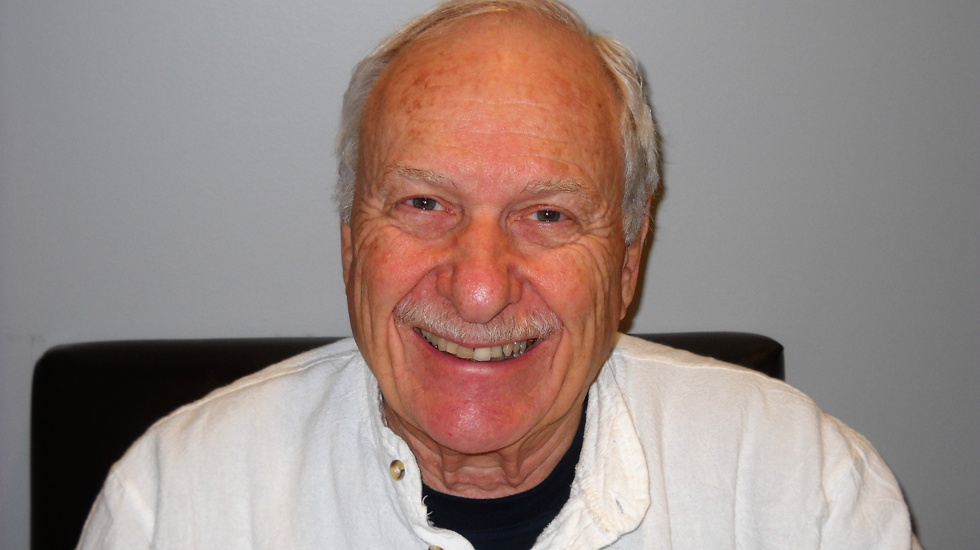
Looking for—and Finding— Wisdom
With
Reynold Ruslan Feldman, Ph.D.

Slide 2
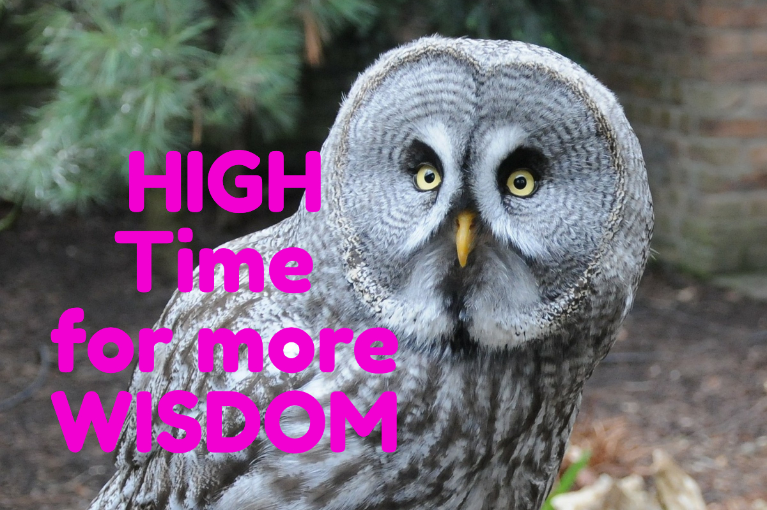
Wisdom is the principal thing; therefore get wisdom.
- Proverbs 4:7, KJV

Slide 3
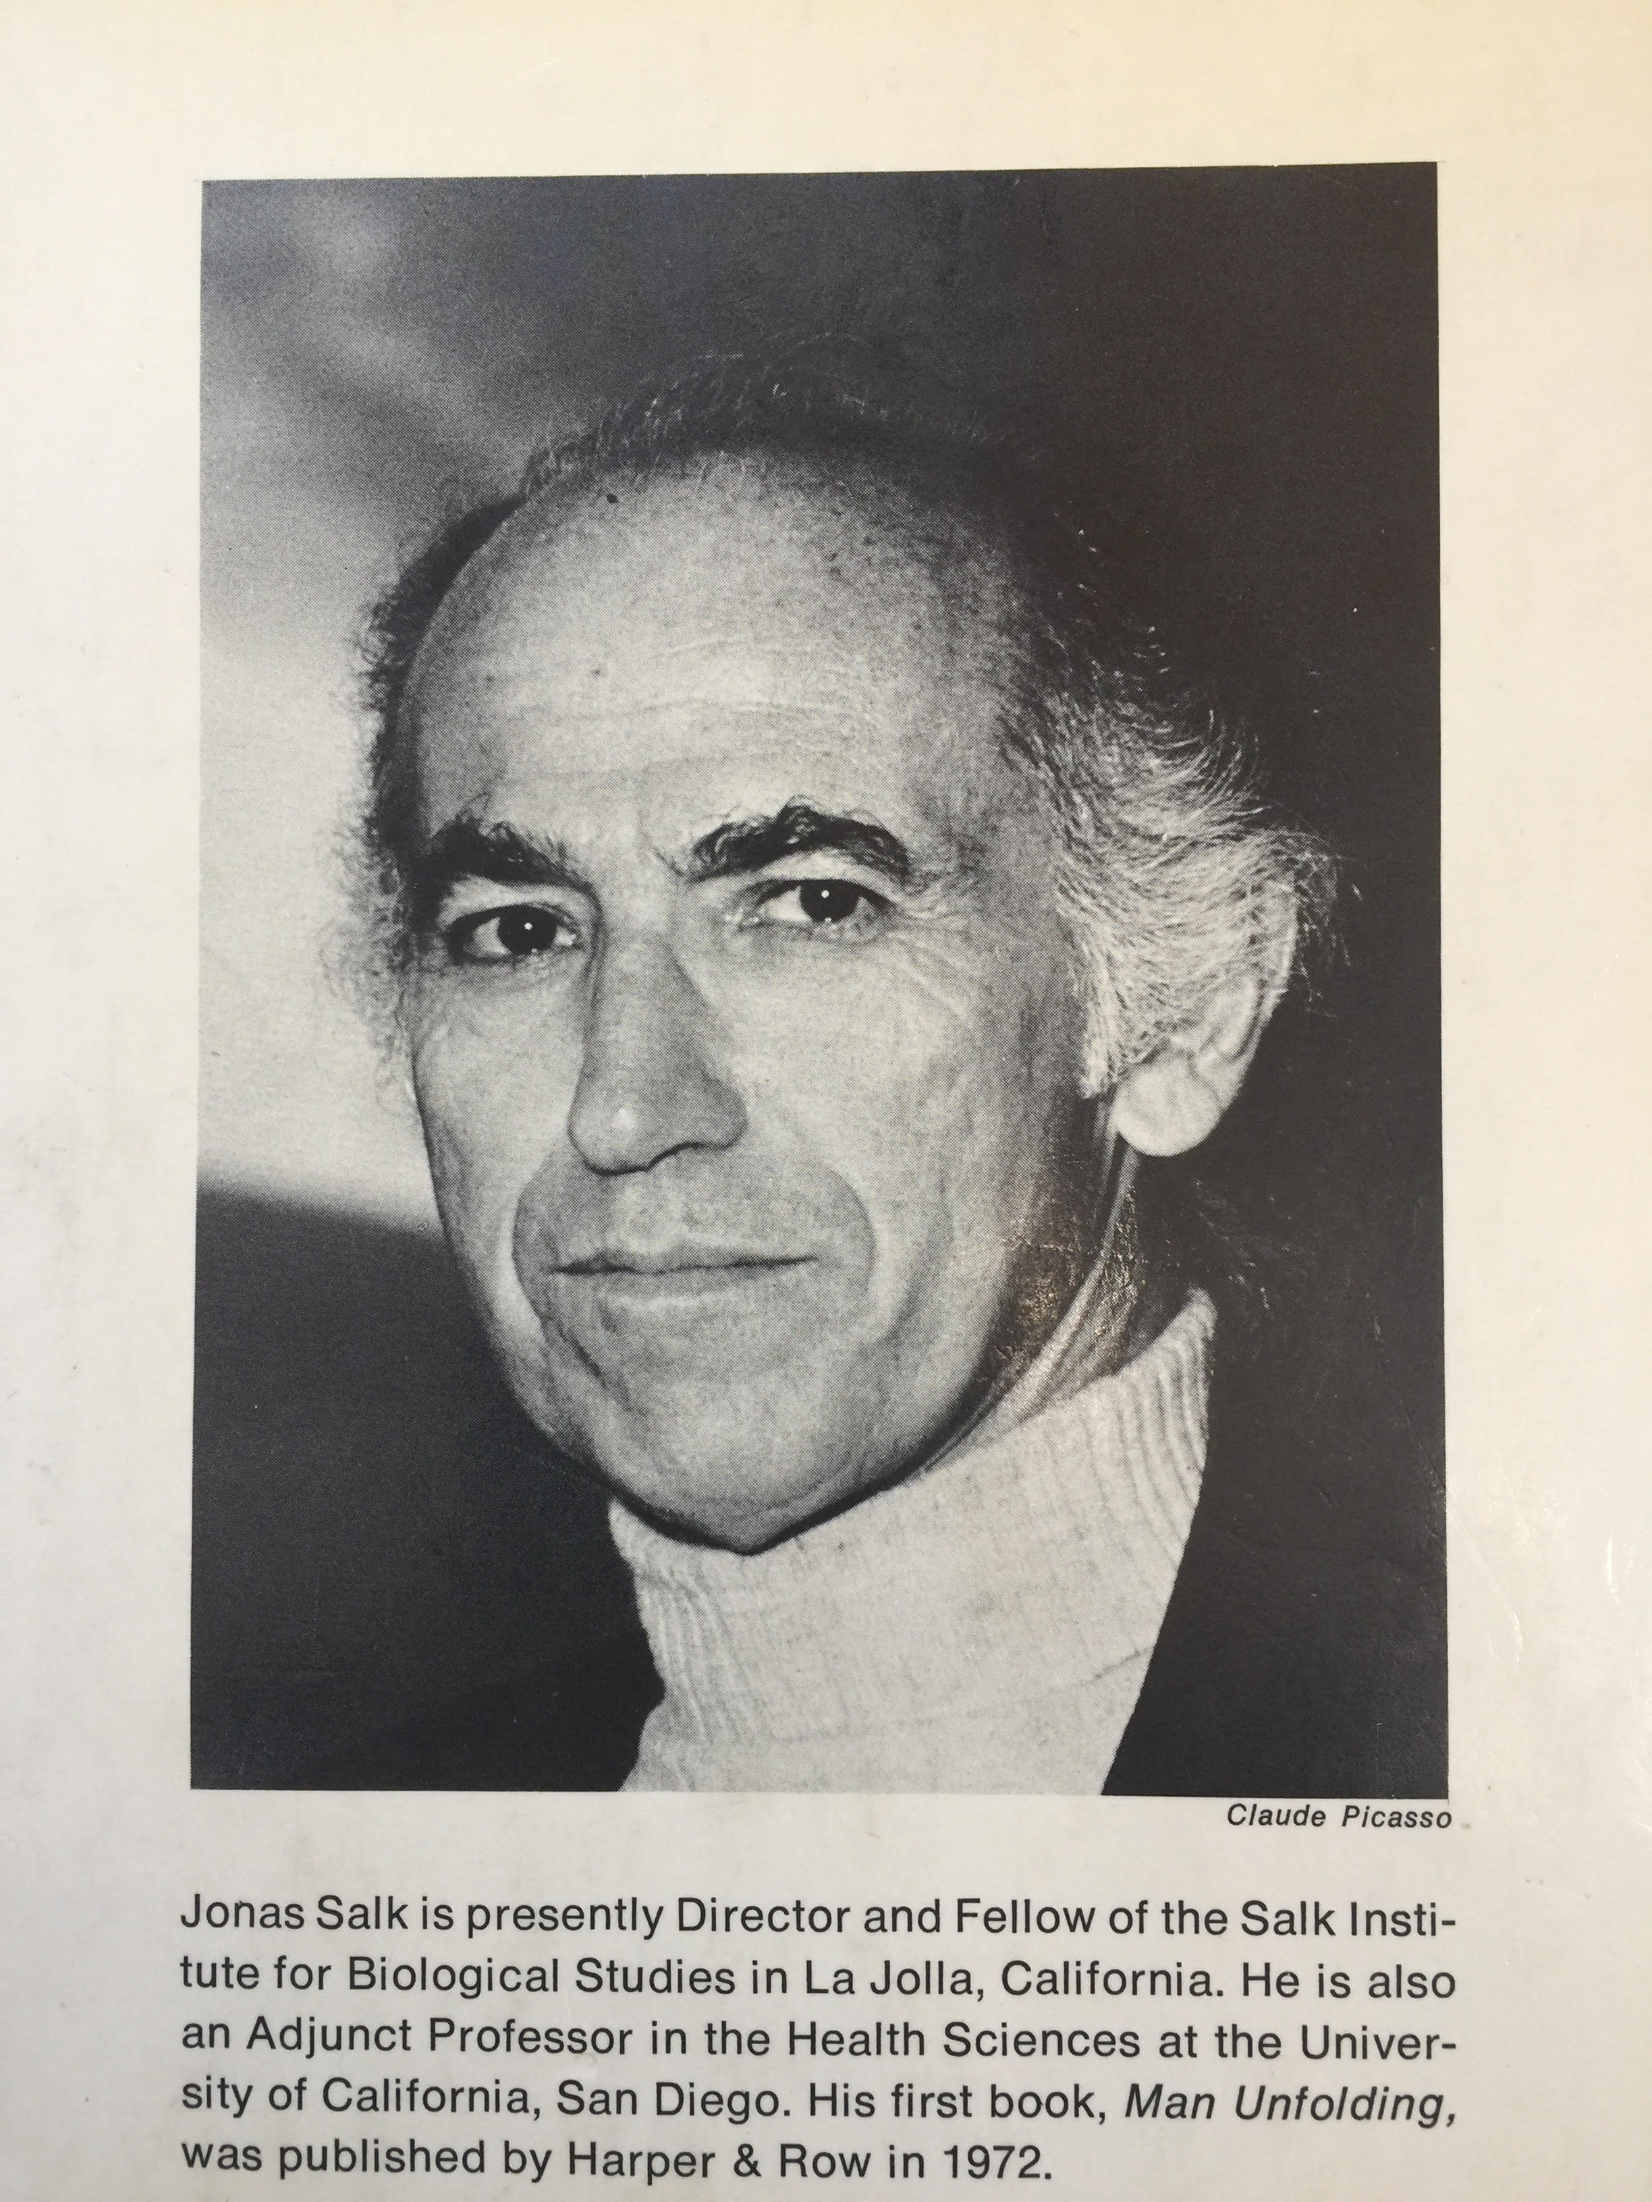
Dr. Jonas Salk (1914-1995)
My Wisdom
Mentor

Slide 4

SURVIVAL OF THE WISEST (1973)
Dr. Salk’s book that set me on my path.

Slide 5
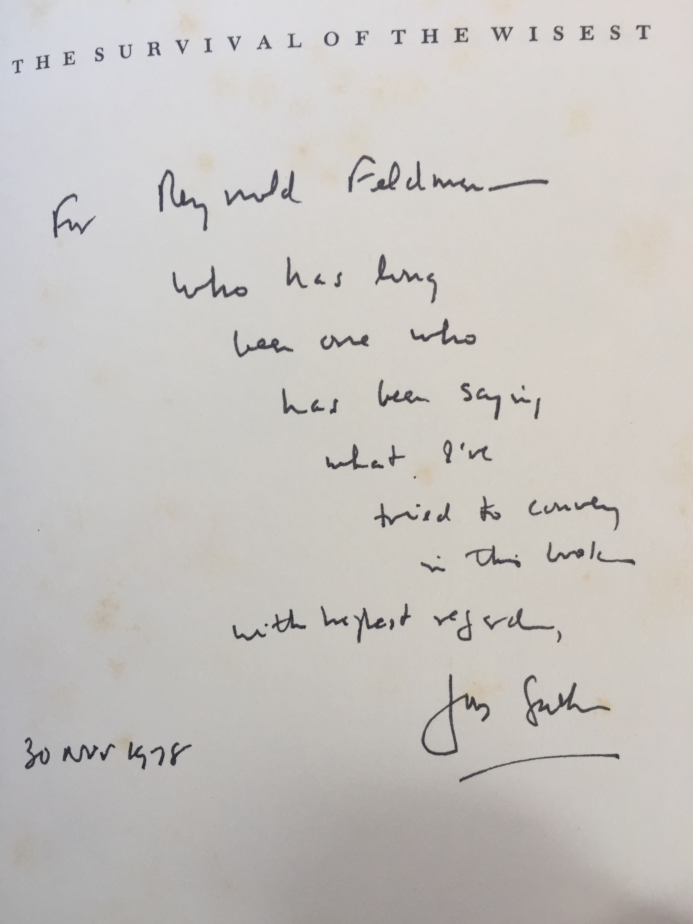
And his flattering inscription . . .

Slide 6

Wisdom = wise + . . .

Slide 7

D U M B !!!

Slide 8


But WISDOM actually derives from . . .
VISIO (Lat.) + DEMAN (O.E.)

Slide 9
Dr. Salk’s Definition of WISDOM—and mine
Wisdom is the human capacity to make decisions that over time prove beneficial to self, others, and the largest possible context.

Slide 10
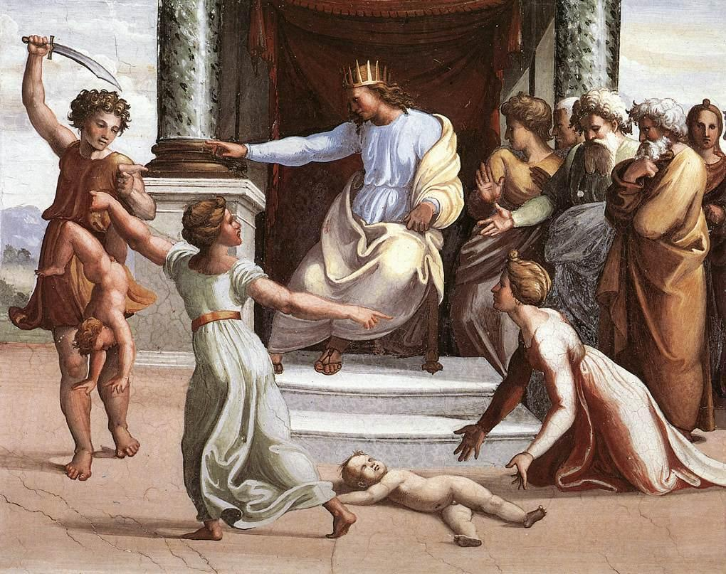
The Judgment of Solomon
Kings, Ch. 3 – Painting by Raphael, d. 1520

Slide 11
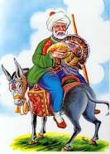
The Mullah Nasruddin – Islam’s Wise Fool

Slide 12
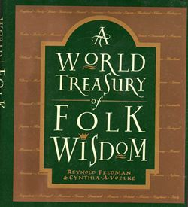

Some are wise and some otherwise.
(English saying) in my first Wisdom book, a proverb collection (1992)
Co-Author: Cynthia A. Voelke
Original English & Chinese Translation (complex characters)

Slide 13

And then came WISDOM (2000)

Slide 14
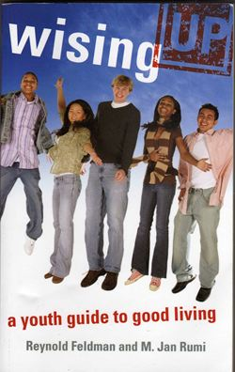
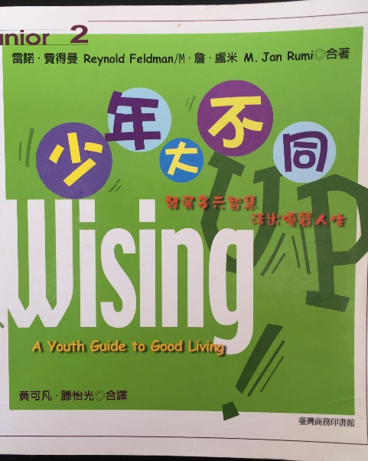

Followed by wisingUP (2007)
Co-Author: M. Jan Rumi (with Chinese & Japanese translations)
Original English, Chinese Translation (complex characters), & Japanese versions

Slide 15

Next came STORIES I REMEMBER (2009)
My 70^{th-}Birthday Memoir

Slide 16
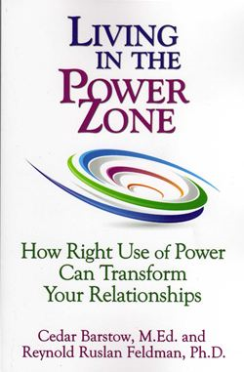
Next:Living in the Power Zone (2013) written with my wife, the now Dr. Cedar Barstow, on using power with wisdom & skill

Slide 17
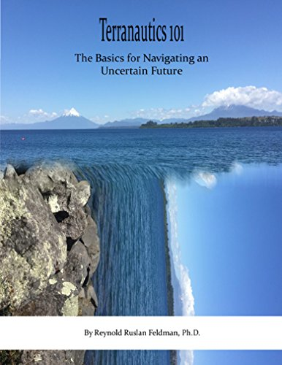
Then came Terranautics 101 (2015)
--an e-book only--

Slide 18
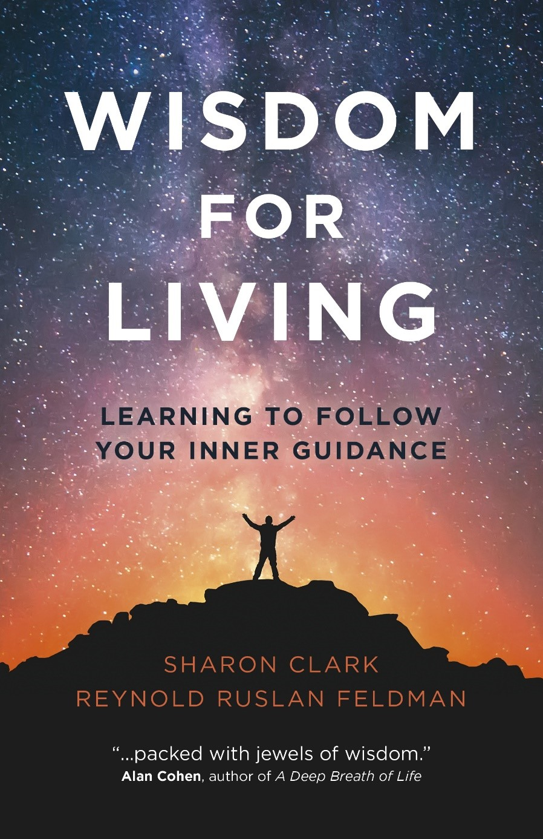
And now—ta-ta-ra-ta!!!
WISDOM FOR LIVING (2019)
Sharon Clark, Co-Author

Slide 19

A few uplifting readings , perhaps?

Slide 20

Sometimes Wisdom comes from the Great Beyond . . . A Story

Slide 21

Your turn to do a wisdom exercise . . .

Slide 22

Commencement Wisdom
“In my end is my beginning.” Mary, Queen of Scots (1541-1587)

